Slide 1
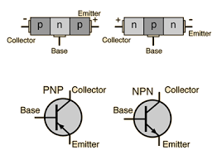
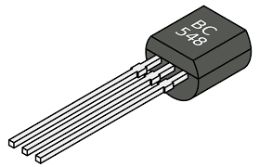
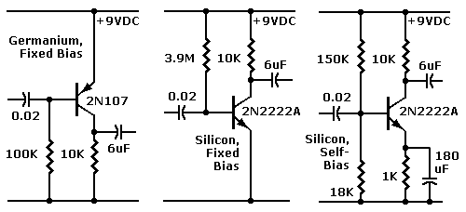
BJT (Bipolar Junction Transistor)

Slide 2
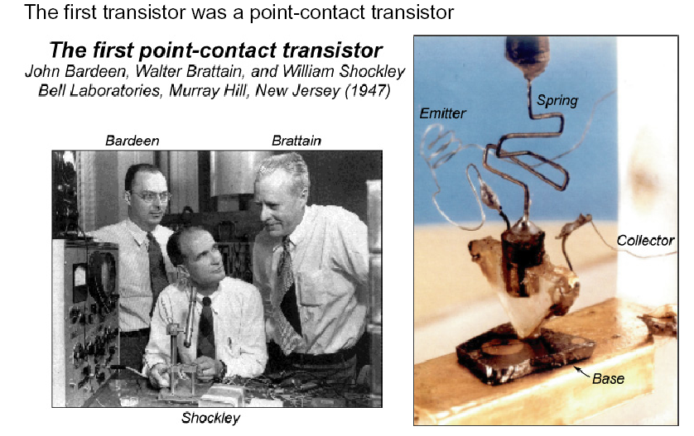
Point-Contact Transistor –
first transistor ever made

Slide 3
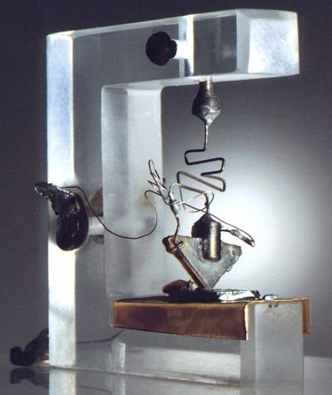
First - BJTs
The transistor was probably the most important invention of the 20th Century.
The story behind the invention is one of clashing egos and top secret research.
Reference:
Bell Labs Museum
B. G. Streetman & S. Banerjee ‘Solid State Electronic Devices’, Prentice Hall 1999.

Slide 4
Interesting story…
Picture shows the workbench of John Bardeen (Stocker Professor at OU) and Walter Brattain at Bell Laboratories.
The experimental results hadn't been very good. Their boss, William Shockley, came near to canceling the project. But in 1947, they built the circuit in the picture.
It was a working amplifier! John and Walter submitted a patent for the first working point contact transistor.

Slide 5
Interesting story…
Shockley was furious and took their work and invented the junction transistor and submitted a patent for it 9 days later.
The three shared a Nobel Prize in 1955. Bardeen and Brattain continued in research (and Bardeen later won another Nobel).
Shockley quit to start a semiconductor company in Palo Alto. It folded, but its staff went on to invent the integrated circuit (the "chip") and to found Intel Corporation.
By 1960, all important computers used transistors for logic, and ferrite cores for memory.

Slide 6
Recall p-n junction
P
N
N
P
W
W
+
+
-
-
V_{appl} > 0
V_{appl} < 0
Forward bias, + on P, - on N
(Depletion region shrinks and then disapper.
Allow holes to jump over barrier
into N region.
Reverse bias, + on N, - on P
(Depletion region expands_{i})
Remove holes and electrons away
from depletion region
I
I
V
V

Slide 7
So if we combine these by fusing their terminals…
P
N
N
P
W
W
+
+
-
-
V_{appl} > 0
V_{appl} < 0
Forward Bias
Reverse Bias
Holes from P region of 1st PN junction are
driven by Forward Bias of 1st PN junction into central N region
Holes in the central N region are attracted by the negative terminal of the Reverse Bias of the 2nd junction.

Slide 8
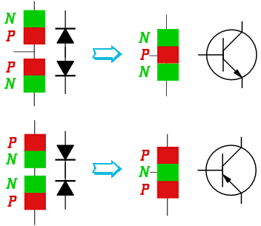
Basic models of BJT
npn transistor
Diode
Diode
pnp transistor
Diode
Diode

Slide 9
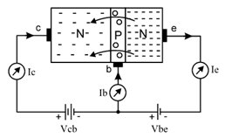
npn BJTs
base layer
collector layer
emitter layer
It contains three semiconductor layers: one p-layer and two n-layers.
The area of collector layer is largest. So it can dissipate heat quickly.
Area of base layer is smallest and it is very thin.
Area of emitter layer is medium.
Collector layer is moderately doped. So it has medium number of charges (electrons).
Base layer is lightly doped. So it has a very few number of charges (holes).
Emitter layer is heavily doped. So it has largest number of charges (electrons).
THE P-LAYER IS SANDWICHED BETWEEN TWO N-LAYERS.
The junction between collector layer and base layer is called as collector-base junction or c-b junction.
The junction between base layer and emitter layer is called as base-emitter junction or b-e junction.
The two junctions have almost same potential barrier voltage of 0.6V to 0.7V, just like in a general purpose diode.

Slide 10
npn BJTs
The collector is connected to high positive voltage with respect to base i.e. V_{cb} is very high. So c-b junction is reverse biased.
When we increase V_{be} ≥ 0.7V (the value 0.7V is a typical value of potential barrier voltage) the transistor (b-e junction) is forward biased.
Now large number of electrons in emitter layer is repelled by negative terminal of V_{be} and they flow towards b-e junction.
They cross the junction and enter into small base layer. Here some electrons combine with holes. Also some of them are attracted by positive terminal of V_{be} and remaining maximum number of electrons flow into collector layer, crossing the second junction i.e. c-b junction.
The resident electrons of collector are repelled by these (guest) electrons and thus, then all the electrons are present in collector layer are attracted by positive terminal of V_{cb}. Thus, all these electrons complete their journey back into emitter layer and produce conventional currents in the transistor as shown in the above circuit.

Slide 11
npn BJTs
Now when V_{be} is still increased, more electrons are repelled by negative terminal of V_{be}. So base-emitter junction is more and more forward biased. Thus, base (I_{b}) and collector currents (I_{c}) increase.
Collector current (I_{c}) is the function of base current (I_{b}).
In all this process, maximum number of electrons from emitter layer flow into collector layer. So collector current is ALMOST EQUAL to emitter current. Hence we say that, collector current is proportional to emitter current.

Slide 12
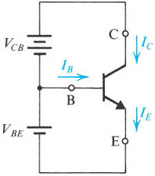
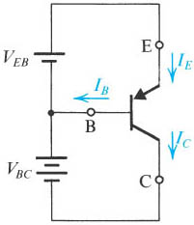
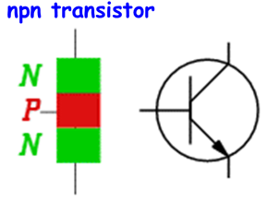
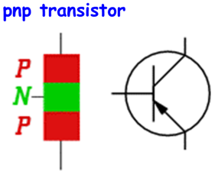
BJT Currents

Slide 13
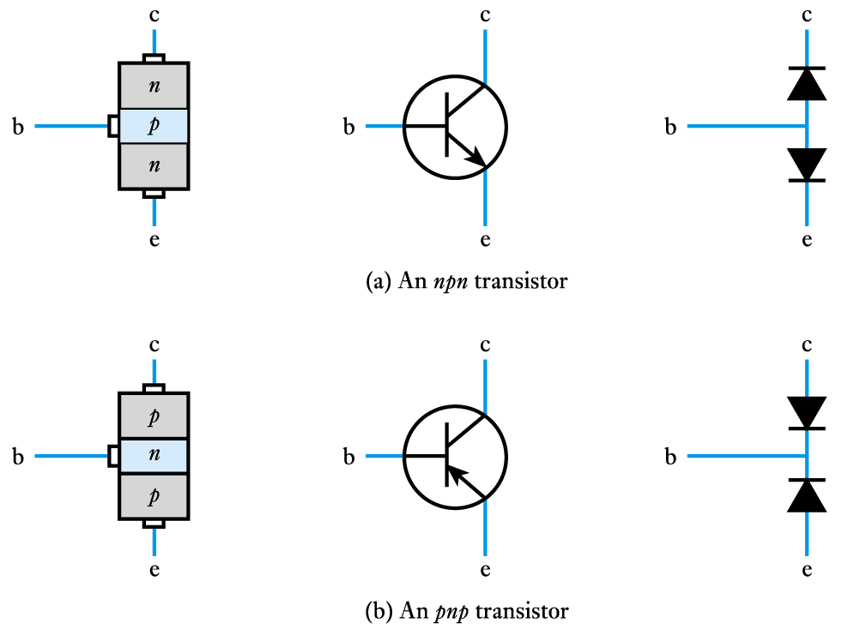
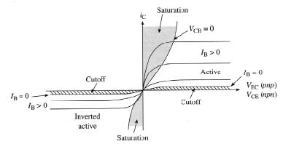
Bipolar Junction Transistors: Operation Modes
Saturation : In this method both the junctions are forward biased. This method is not useful as the transistor is in “saturation” and the current cannot be controlled easily.
Cutoff: In this method both the junctions are reverse biased. This method is also not useful as the transistor is in “cut-off” state since current is zero.
Active: This is the most common and popular method used in transistor biasing. In this method, the base-emitter junction is forward biased and collector-base junction is reverse biased. So by adjusting base voltage we can control total current in the transistor easily.
Bias Mode | E-B Junction | C-B Junction
Saturation | Forward | Forward
Active | Forward | Reverse
Cutoff | Reverse | Reverse
Operational modes are defined based on V_{BE} and V_{BC}

Slide 14
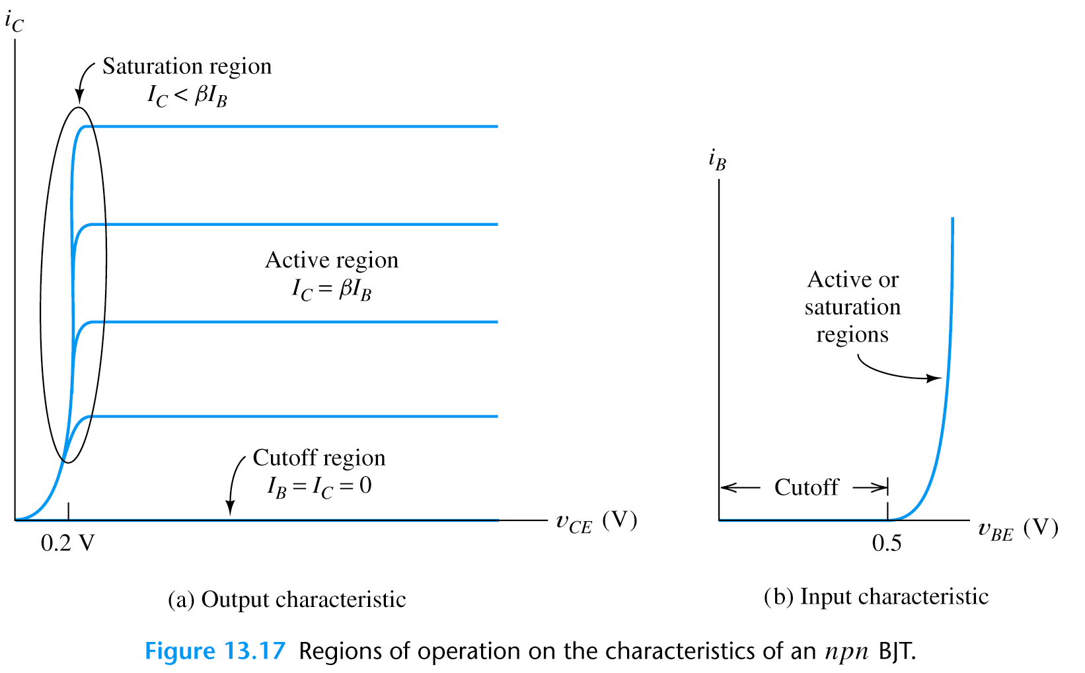
BJT Operating Regions and I V Curves
Output characteristics
region near to the origin is the saturation region
this is normally avoided in linear circuits
Input characteristics
the input takes the form of a forward-biased pn junction
the input characteristics are similar to a semiconductor diode

Slide 15
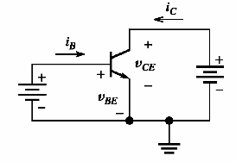
BJTs – Current & Voltage Relationships
Operation mode: v_{BE} is forward & v_{BC} is reverse (Active mode)
The Shockley equation
I_{ES}=saturation current (10⁻¹²-10⁻¹⁶A); V_{T}=kT/q -thermal V (26mV)
The Kirchhoff’s laws
It is true regardless of the bias
conditions of the junction
Useful
parameter

Slide 16
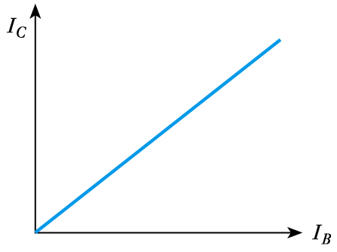
Relationship between the collector current and the base current
characteristic is approximately linear
magnitude of collector current is generally many times that of the base current
the device provides current gain
It is true regardless of the bias
conditions of the junction
Useful
parameter

Slide 17
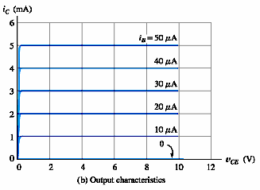
Example:
Please calculate the current gain (β) of this transistor

Slide 18
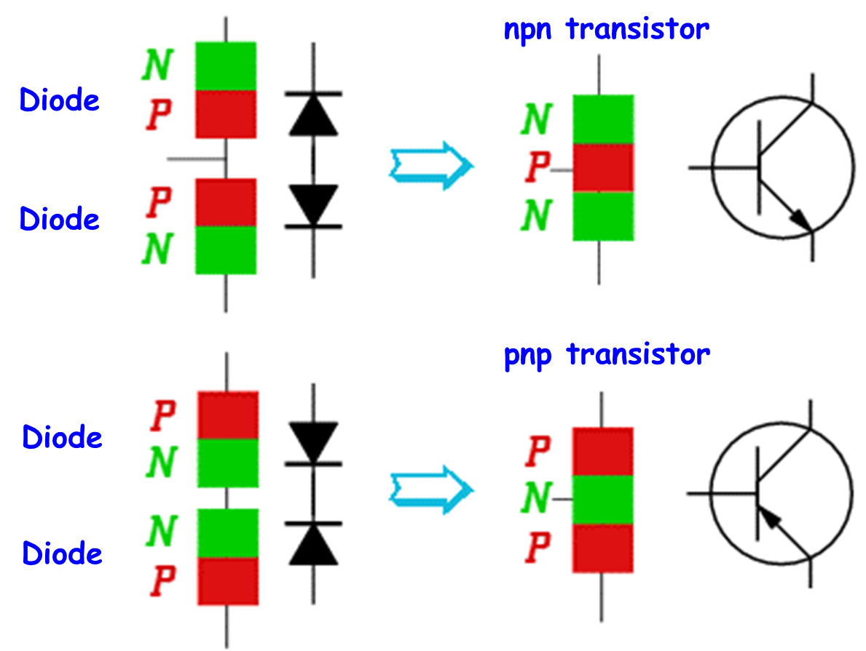
Voltage polarities and current flow
if transistors are biased in the active mode.
Notes:
sedr42021_0514a.jpg

Slide 19
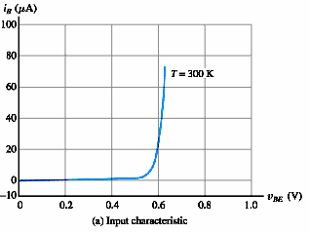
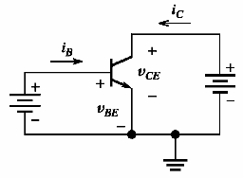
BJTs – Characteristics
npn transistor
V_{CE}>V_{BE} , B-C junction is reverse biased. V_{E}<V_{B} ,BE junction is forward biased (active region)
Output
Input
if V_{C}<V_{B} and V_{E}<V_{B}, BC and BE junctions are forward biased, respectively (saturation region)
Remember V_{BE} has to be greater than 0.6-0.7 V

Slide 20
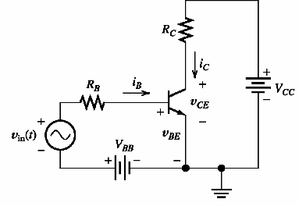
BJTs – Load line analysis
V_{BB}/R_{B}
v_{BB}
Input loop
if i_{B}=0
if v_{BE}=0

Slide 21
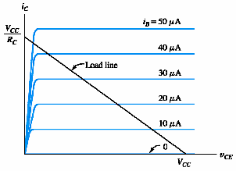
BJTs – Load line analysis
Output loop

Slide 22
Load Line Analysis:
Can be performed in order to determine |V_{BE}| value of transistor in the active and saturation regions.
or
Assumption:
It is assumed that |V_{BE}| = 0.7V in the active and saturation regions.

Slide 23
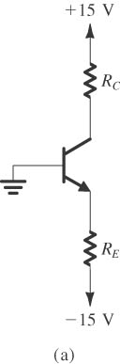
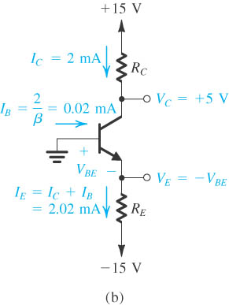
Problem : Analyze the circuit shown in figure to determine current (I) and voltage (V) values. For the transistor, assume that β = 100 and
|V_{BE}| = 0.7V in the active region. (R_{C}=5kΩ, R_{E}=7.07kΩ)
Notes:
sedr42021_0515a.jpg

Slide 24
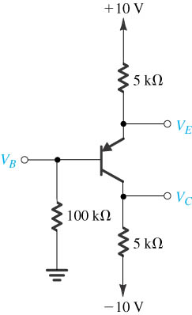
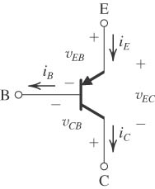
Problem : Analyze the circuit shown in Figure to determine I and V values. For the transistor, assume that β = 100 and |V_{BE}| = 0.7V in the active region.
Notes:
sedr42021_0515a.jpg

Slide 25
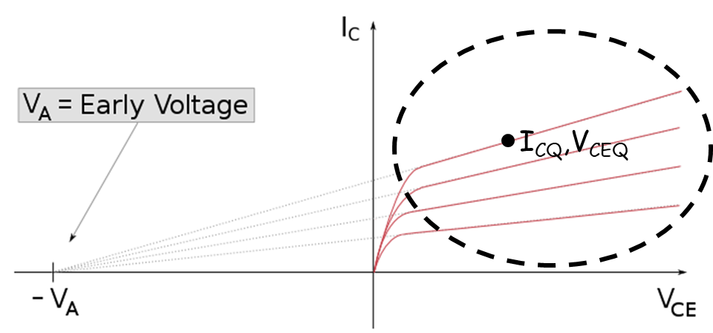
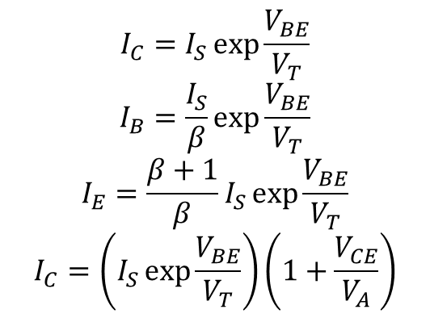
Early Effect
Ideal: Slope is zero
$$I_{C}=I_{S}\exp{\frac{V_{BE}}{V_{T}}}$$
$$I_{B}=\frac{I_{S}}{β}\exp{\frac{V_{BE}}{V_{T}}}$$
$$I_{E}=\frac{β+1}{β}I_{S}\exp{\frac{V_{BE}}{V_{T}}}$$
$$I_{C}=\left(I_{S}\exp{\frac{V_{BE}}{V_{T}}}\right)\left(1+\frac{V_{CE}}{V_{A}}\right)$$
Early Effect
Reallity: Slope is not zero. This nonlinear behaviour is modeled by ‘Early Voltage’ (V_{A}).

Slide 26
DC Biasing Circuits of BJTs

Slide 27
Objectives
State the purpose of DC biasing circuits.
Plot the DC load line for the given the value of V_{CC} .
Describe the Q-point of an amplifier.
Describe and analyze the operations of various bias circuits:
base-bias circuits
voltage-divider bias circuits
emitter-bias circuits
collector-feedback bias circuits
emitter-feedback bias circuits

Slide 28
A generic DC load line.

Slide 29
Example
Plot the DC load line for the circuit shown in Figure.

Slide 30
Example
Plot the DC load line for the circuit shown in Fig. Then, find the values of V_{CE} for I_{C} = 1, 2, 5 mA respectively.
I_{C} (mA) | V_{CE} (V)
1 | 9
2 | 8
5 | 5
Different operating points

Slide 31
Optimum Q-point with amplifier operation.

Slide 32
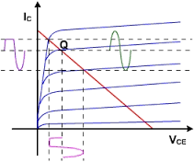
Q-point is not at optimum location
Amplitude of input signal can not be too great
Min V_{ce} voltage
Max I_{c} current
Clipping
Clipping

Slide 33
BIAS CIRCUITS
Assumption:
|V_{BE}| = 0.7V
1. Base bias (fixed bias).
β = DC current gain = h_{FE}

Slide 34
Example
Construct the DC load line for the circuit and plot the Q-point. Determine whether the circuit is midpoint biased.

Slide 35
Example Construct the DC load line for the circuit
The circuit is midpoint biased.

Slide 36
(Q-point shift)
The transistor has values of h_{FE} = 100 when T = 25 °C and h_{FE} = 150 when T = 100 °C. Determine the Q-point values of I_{C} and V_{CE} at both of these temperatures. V_{BE}=0.7V
Temp(°C) | I_{B} (μA) | I_{C} (mA) | V_{CE} (V)
25 | 20.28 | 2.028 | 3.94
100 | 20.28 | 3.04 | 1.92
Q(100⁰C)
(25⁰C)

Slide 37
Base bias characteristics.
Circuit recognition: A single resistor (R_{B}) between the base terminal and V_{CC}. No emitter resistor.
Advantage: Circuit simplicity.
Disadvantage: Q-point shift with temp.
Applications: Switching circuits only.

Slide 38
2. Voltage divider bias.
Assumption:
|V_{BE}| = 0.7V
Assume that I₂ > 10I_{B}. Therefore, we can neglect I_{B}
Assume that I_{CQ} ≅ I_{E} (h_{FE} >> 1). Then
Operating point

Slide 39
Example
Assumption:
|V_{BE}| = 0.7V
Determine the values of I_{CQ} and V_{CEQ} for the circuit shown in Fig.
Because I_{CQ} @ I_{E} (or h_{FE} >> 1),

Slide 40
Example
Verify that I₂ > 10 I_{B}

Slide 41
Which value of h_{FE} do I use?
Transistor datasheet may list any combination of the following h_{FE} max, h_{FE} min or h_{FE} typ. Use typical value if there is one. Otherwise, use

Slide 42
Example
A voltage-divider bias circuit has the following values:
R₁ = 1.5 kΩ, R₂ = 680 Ω, R_{C} = 260 Ω, R_{E} = 240 Ω and V_{CC} = 10 V. Assuming the transistor is a 2N3904, determine the value of I_{B} for the circuit.

Slide 43
Stability of Voltage Divider Bias Circuit
The Q-point of voltage divider bias circuit is less dependent on h_{FE} than that of the base bias (fixed bias).
I_{E} is determined by V_{CC}, R₁, R₂ and V_{BE} voltage of transistor. Their values hardly change with the change of temperature.
For example, if I_{E} is exactly 10 mA and the range of h_{FE} is from 100 to 300. Then,
I_{CQ} hardly changes over the entire range of h_{FE}.

Slide 44
Load line for voltage divider bias circuit.
Circuit values are from previous example.

Slide 45
Voltage-divider bias characteristics.
Circuit recognition: The voltage divider in the base circuit.
Advantages: The circuit Q-point values are stable against changes in h_{FE}.
Disadvantages: Requires more components than most other biasing circuits.
Applications: Used primarily to bias linear amplifier.

Slide 46
3. Emitter bias.
Assume that the transistor operation is in active region.
Assume that h_{FE} >> 1.

Slide 47
Example
Determine the values of I_{CQ} and V_{CEQ} for the amplifier shown in Fig.

Slide 48
Load Line for Emitter-Bias Circuit
Assume that h_{FE} >> 1.

Slide 49
Circuit Stability of Emitter-Bias Circuit
h_{FE} increases
I_{C} and I_{E} increase (if I_{B} is the same)
V_{E} and then V_{B} increase
I_{B} decreases
I_{C} does not increase that much.
Good Stability. Less dependent on h_{FE} and temperature.

Slide 50
Emitter-bias characteristics.
Circuit recognition: A split (dual-polairty) power supply and the base resistor is connected to ground.
Advantage: The circuit Q-point values are stable against changes in h_{FE}.
Disadvantage: Requires the use of dual-polarity power supply.
Applications: Used primarily to bias linear amplifiers.

Slide 51
4. Collector-feedback bias.

Slide 52
Example
Determine the values of I_{CQ} and V_{CEQ} for the amplifier shown in Fig.

Slide 53
Circuit Stability of Collector-Feedback Bias
h_{FE} increases
I_{C} increases (if I_{B} is the same)
V_{CE} decreases
I_{B} decreases
I_{C} does not increase that much.
Good Stability. Less dependent on h_{FE} and temperature.

Slide 54
Collector-Feedback Characteristics
Circuit recognition: The base resistor is connected between the base and the collector terminals of the transistor.
Advantage: A simple circuit with relatively stable Q-point.
Disadvantage: Relatively poor AC characteristics.
Applications: Used primarily to bias linear amplifiers.

Slide 55
5. Emitter-feedback bias.

Slide 56
Example

Slide 57
Circuit Stability of Emitter-Feedback Bias
h_{FE} increases
I_{C} , I_{E} increases (if I_{B} is the same)
V_{E} increases
I_{B} decreases
I_{C} does not increase that much.
I_{C} is less dependent on h_{FE} and temperature.

Slide 58
Emitter-Feedback Characteristics
Circuit recognition: Similar to voltage divider bias with R₂ missing (or base bias with R_{E} added).
Advantage: A simple circuit with relatively stable Q-point.
Disadvantage: Requires more components than collector-feedback bias.
Applications: Used primarily to bias linear amplifiers.

Slide 59
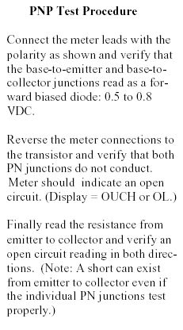
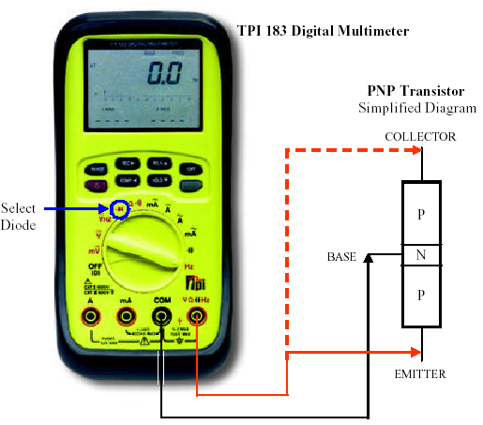
BJTs – Testing

Slide 60
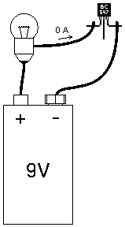
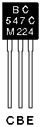
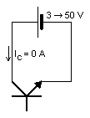
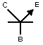
BJTs – Practical Aspects
npn

Slide 61
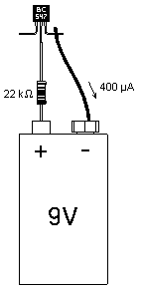
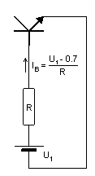

Slide 62
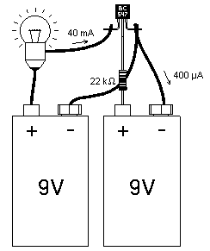
y
y
npn

Slide 63
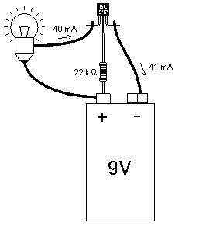
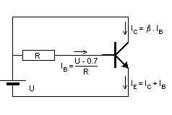
npn

Slide 64
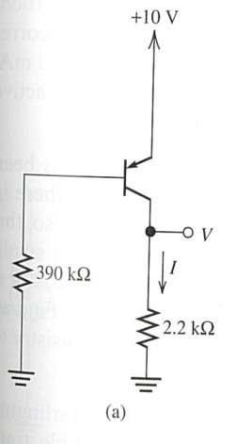
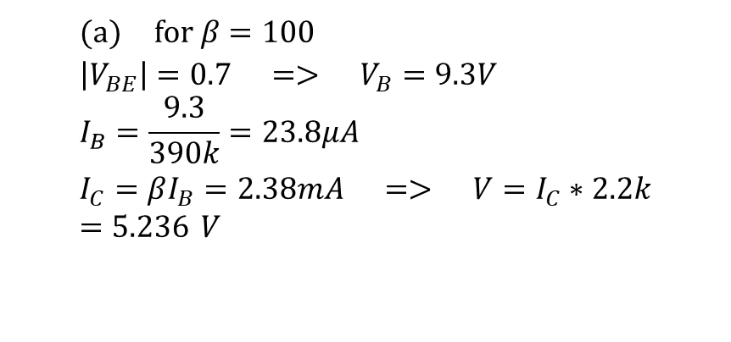
Problem : Analyze the circuits shown in Figure to determine I and V. For all transistors, assume that β = 100 and |V_{BE}| = 0.7V in the active region.
$$(a) \text{for} β=100 \\ \left|V_{BE}\right|=0.7 => V_{B}=9.3V \\ I_{B}=\frac{9.3}{390k}=23.8μA \\ I_{C}=βI_{B}=2.38mA => V=I_{C}∗2.2k=5.236 V$$

Slide 65
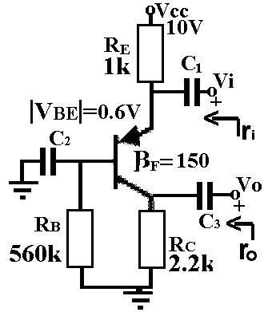
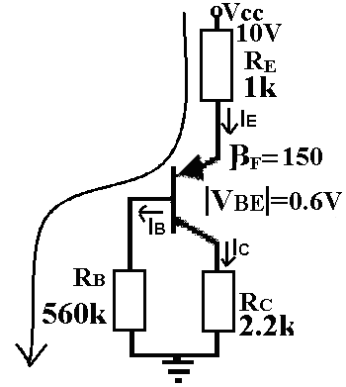
Consider the amplifier circuit shown below. Use the following parameters for your calculations. Transistor parameters : β=150, |VBE|=0.6V
a. Perform DC analysis and calculate DC operating values of the transistor.

Slide 66
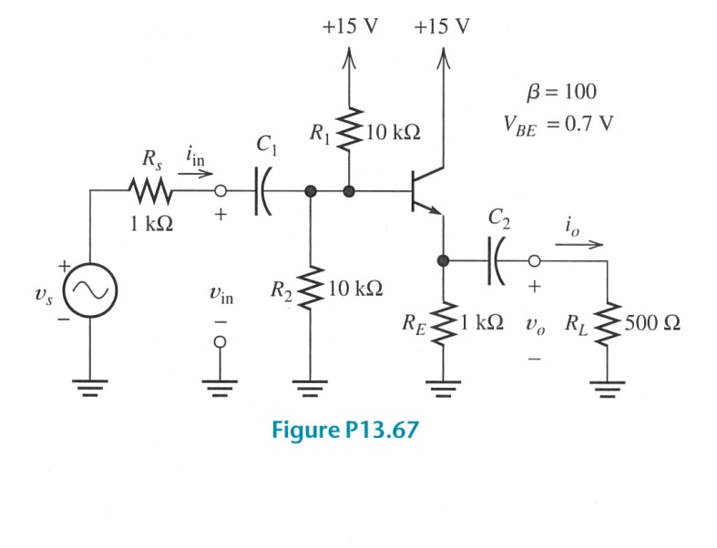
Problem: Consider the emitter-follower amplifier of figure. Draw the DC circuit and find I_{CQ} (β = 100, V_{BE}=0.7V).
I₁

Slide 67
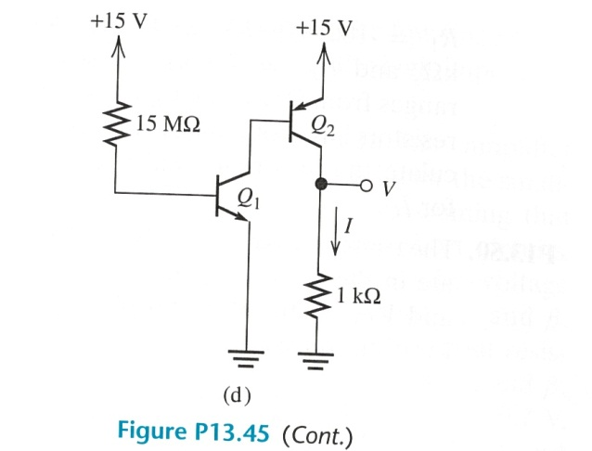
Problem : Analyze the circuits shown in figure to determine I and V. For all transistors, assume that β = 100 and |V_{BE}| = 0.7V in the active region.

Slide 68
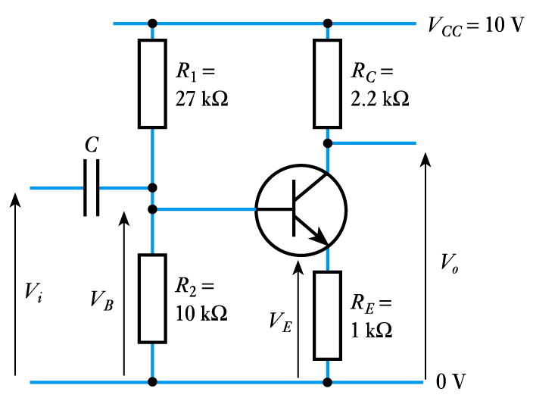
Problem: Suppose that npn transistor has V_{BE} = 0.7V. Determine I_{C} and V_{CE} and output voltage.
Assume that Base current is small, so
Emitter voltage
V_{E} = V_{B} – V_{BE} = 2.7 – 0.7 = 2.0 V
Emitter current
Since I_{B} is small, collector current I_{C} ≈ I_{E} = 2 mA
Output voltage = V_{CC} – I_{C}R_{C} = 10 - 2 mA ×2.2 kΩ = 5.6 V

Slide 69
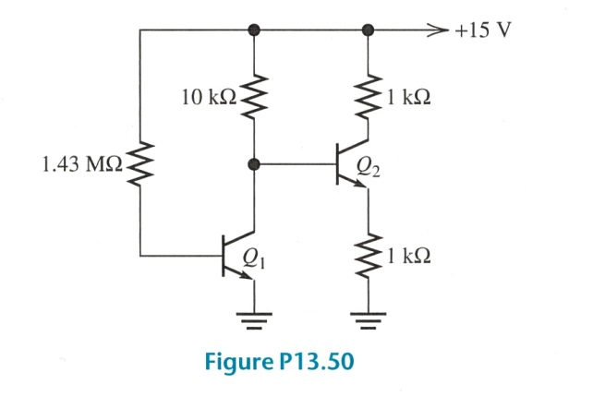
Problem: The transistors shown in figure operate in active region and have β = 100, V_{BE}=0.7V. Determine I_{C} and V_{CE} for each transistor.
I₁
I_{E2}
V_{BE}
15V- I_{B1} 1.43MΩ-V_{BE1} =0 => I_{B1} SOLVED
15V-(I_{C1}+I_{B2})10kΩ-V_{BE2} – (β+1) I_{B2} 1kΩ =0 => I_{B2} SOLVED
15V- I_{C2} 1kΩ-V_{CE2} – (β+1) I_{B2} 1kΩ =0 => V_{CE2} SOLVED

Slide 70
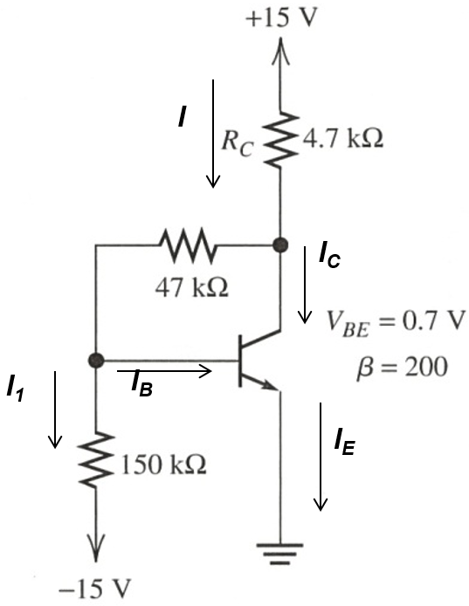
Problem: Analyze the circuit of figure and determine I_{C} and V_{CE}. (β = 100, V_{BE}=0.7V)
V_{B} = 0.7V
V_{B} - I₁ 150KΩ = -15V => I₁ SOLVED
15V- (I_{B} + β I_{B} + I₁) 4.7kΩ- (I_{B} + I₁) 47kΩ = V_{B}
=> I_{B} SOLVED
15V- (I_{B} + β I_{B} + I₁) 4.7kΩ- V_{CE} = 0
=> V_{CE} SOLVED

Slide 71
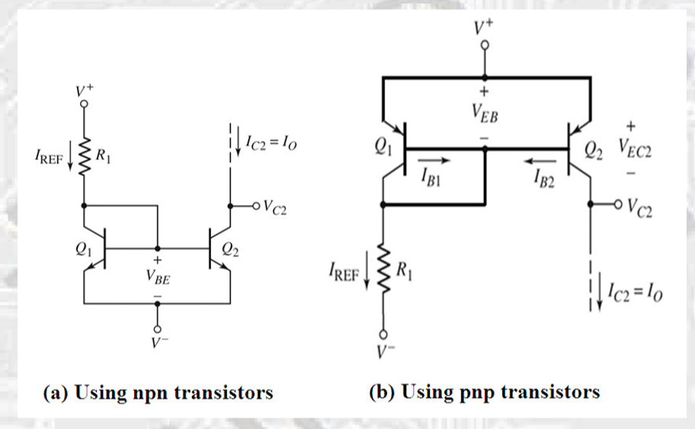


Current Mirror
The following circuits show how matched transistors, when combined with a few resistors, can act as current sources.
A current mirror is a circuit designed to copy a current through one active device by controlling the current in another active device of a circuit, keeping the output current constant regardless of loading.

Slide 72


Current Mirror
$$I_{C}=I_{S}\exp{\frac{V_{BE}}{V_{T}}}$$

Slide 73

Current Mirror Equations considering Early Effect
(I_{C2})
V_{CE1} =V_{BE1}
(V_{CE2})

Slide 74

Finite output resistance

Slide 75

Current Mirror

Slide 76



Noise in Audio Amplifier
Consider the amplifier below which amplifies an audio signal from a microphone.
If the power supply (V_{CC}) is time-varying, it will result in an additional (undesirable) voltage signal at the output, perceived as a “humming” noise by the user.

Slide 77

Supply Ripple Rejection
Since node X and Y each see the voltage ripple, their voltage difference (V_{out}) will be free of ripple. Transistors are exactly same.

Slide 78

BJT Differential Pair
With the addition of a “tail current,” an elegant and robust differential pair is achieved. Transistors are exactly the same.

Slide 79


Differential Amplifiers
$$I_{C}=I_{S}\exp{\frac{V_{BE}}{V_{T}}}$$
$$I_{C}={αI}_{E}$$

Slide 80
Differential Amplifiers

Slide 81



Small-Signal Analysis
What happens is a small signal v_{i} is superimposed on the DC voltage
Graphical construction for the determination of the base current (input)
Graphical construction for the determination of the collector current (output)
Notes:
sedr42021_0527.jpg

Slide 82


Small-Signal Analysis
Load line for min. v_{i} value
Superimposed v_{i}
Graphical determination of the signal components v_{be}, i_{b}, i_{c}, and v_{ce} when a signal component v_{i} is superimposed on the dc voltage V_{BB}
Notes:
sedr42021_0530a.jpg

Slide 83







Small-Signal Equivalent Circuit (hybrid-π small-signal model)
Small signal equivalent circuit for npn BJT:
Assumption: Early Voltage (V_{A}) is infinite.
$$i_{B}=I_{BQ}+i_{b}(t)$$
Slope=$\frac{1}{r_{π}}$
Transistor is modeled by using input resistance and output current
$$i_{E}=I_{ES}\left[\exp\left(\frac{v_{BE}}{V_{T}}\right)−1\right]$$
$$i_{b}(t)=\frac{v_{be}(t)}{r_{π}}$$
and
$i_{B}=I_{ES}\left[\exp\left(\frac{v_{BE}}{V_{T}}\right)−1\right]$/(β+1)
$$r_{π}={\left[\frac{di_{B}(t)}{{dv}_{BE}(t)}\right]}_{Q}^{−1}$$

Slide 84




Early Effect
I_{CQ},V_{CEQ}
Small signal equivalent circuit
βi_{b}
This nonlinear behaviour is modeled by a resistor.

Slide 85



Two versions of the hybrid-π small-signal model
$v_{be}=r_{π}$ $i_{b}$

Slide 86
DC ANALYSIS
^{V}CC
R₁
R_{C}
^{C}out
R_{S}
^{C}in
+
v_{s}
-
+
Q₁
+
R_{L} v_{o}
-
^{v}in
R_{E}
R₂
C_{E}
-
Replace all capacitors with OPEN circuits.
Set all AC sources to zero, because they have zero signal component!!!

Slide 87
Constructing the Small-Signal Equivalent Circuit
^{V}CC
R₁
R_{C}
^{C}out
R_{S}
^{C}in
+
v_{s}
-
+
Q₁
+
R_{L} v_{o}
-
^{v}in
R_{E}
R₂
C_{E}
-
To construct small-signal equivalent circuit for entire amplifier, we:
Replace the BJT by its small-signal model.
Replace all capacitors with short circuits.
Set all DC sources to zero, because they have zero signal component!!!
The result is the small-signal equivalent circuit of the amplifier:

Slide 88

Small-Signal Analysis
First perform DC analysis to find small-signal equivalent parameters at the operating point.
Then:
To construct small-signal equivalent circuit for entire amplifier, we:
Replace the BJT by its small-signal model.
Replace all capacitors with short circuits.
Set all DC sources to zero, because they have zero signal component!!!
The result is the small-signal equivalent circuit of the amplifier.

Slide 89

Small-Signal Analysis
Find voltage gain:
A_{voc:} Open circut gain. Gain without ‘Load’

Slide 90


Small-Signal Analysis
Find input impedance:
Find output impedance:
Z₀ = v_{o} / i_{o}=R_{c}

Slide 91

Input/Output Impedances
The figure above shows the techniques of measuring input and output impedances.
When measuring output impedance, the input port has to be grounded.

Slide 92

Input Impedance Example I
When calculating input/output impedance, small-signal analysis is assumed.

Slide 93

Output Impedance Example I

Slide 94

Impedance at Emitter
The impedance seen at the emitter of a transistor is approximately equal to one over its transconductance (if the base is grounded).

Slide 95


Amplifier Circuits

Slide 96





Common-Emitter (CE) Amplifier
$$v_{out}={{−R}_{c}{ g}_{m}v}_{π}$$
$v_{in}$ $=v_{π}$
$$A_{v}=\frac{v_{out}}{v_{in}} \\ A_{v}=−g_{m}R_{C}$$

Slide 97

I/O Impedances of CE Amplifier
When measuring output impedance, the input port has to be grounded so that V_{in} = 0.

Slide 98

Inclusion of Early Effect
Early effect will lower the gain of the CE amplifier, as it appears in parallel with R_{C}.

Slide 99



Slide 100









Consider an amplifier shown below. Suppose that the value of the coupling capacitors Cc1 and Cc2 are high enough, so they can be considered shorted in small signal analysis. Find the small signal values of Zin, Zout, and vout/vin.
NPN Transistor Parameters: VBE = 0.7, β = 40, VA = ∞, VT = 25 mV.
i_{in}
v_{in}
i_{b}
i_{c}
i₀
b
c
v_{out}
=>
v_{in}
βi_{b}
R₁//R₂
r_{π}
R₃
e
i_{c}
$v_{be}=v_{in}$ = $i_{b}{ r}_{π}=i_{in}{(R}_{1 }{//R}_{2}{//r}_{π})$
$$v_{out}={{−R}_{3} β i}_{b}$$
$Z_{in}=\frac{v_{in}}{{ i}_{in }} =R1 //R2 //r$_{π}
$$\frac{v_{out}}{v_{in}}=\frac{{−R}_{3} β }{{ r}_{π}}$$
$$Z_{out}=\frac{v_{0}}{{ i}_{0 }} =R3$$

Slide 101

The parameters of the transistor are β = 100, V_{BE}=0.7V and V_{A} =∞.
(a) Find the DC voltages at the base and emitter terminals.
(b) Find R_{C} such that V_{CEQ} = 3.5 V.
(c) Assuming C_{C} and C_{E} act as short circuits, determine the small-signal voltage gain A_{v} = v_{o} /v_{s}.

Slide 102





Continue: The parameters of the transistor are β = 100, V_{BE}=0.7V and V_{A} =∞.
R_{s}
i_{b}
i_{c}
b
c
v₀
=>
v_{s}
βi_{b}
R_{B}
r_{π}
R_{c}
e
i_{c}
$${ R}_{B}//r_{π}={(r}_{π}{ R}_{B})/{(r}_{π}{+R}_{B})$$
$v_{be}=\frac{{ R}_{B}//r_{π}}{R_{s}+{ R}_{B}//r_{π}}v_{s}$= $i_{b}{ r}_{π}$
$$v_{0}={{−R}_{c} β i}_{b}$$
$$\frac{v_{0}}{v_{s}}=\frac{−{ R}_{B}//r_{π}}{{ r}_{π }{ (R}_{s}+{ R}_{B}//r_{π})}R_{c} β$$

Slide 103







Consider the amplifier shown above. Use the following parameters for your calculations. Transistor parameters : β=200, VBE=0.7V, VT=25mV, VA=∞
a. Find VB and V0 of the transistor by performing DC analysis.
b. Find the small signal values of Zin, Zout, and vo/vin.
5V- I_{B} 400kΩ-V_{BE} =0 => I_{B} SOLVED
V_{BE} =V_{B} =0.7V
5V- β I_{B} 1.2kΩ =V₀ => V₀ SOLVED
R_{s}
i_{in}
i_{b}
i_{c}
i₀
b
c
v₀
v_{i}
βi_{b}
R_{B}
r_{π}
R_{c}
e
$v_{be}=\frac{{ R}_{B}//r_{π}}{R_{s}+{ R}_{B}//r_{π}}v_{i}$= $i_{b}{ r}_{π}$
$$\frac{v_{0}}{v_{i}}=\frac{−{ R}_{B}//r_{π}}{{ r}_{π }(R_{s}+{ R}_{B}//r_{π})}R_{c} β$$
$Z_{in}=\frac{v_{in}}{{ i}_{in }} =RB //r$_{π}
$$Z_{out}=\frac{v_{0}}{{ i}_{0 }} =Rc$$
$$v_{0}={{−R}_{c} β i}_{b}$$

Slide 104

Emitter Degeneration
By inserting a resistor in series with the emitter, this topology will decrease the gain of the amplifier but improve other aspects, such as linearity, and input impedance.

Slide 105






Small-Signal Model
$$v_{out}={{−R}_{c}{ g}_{m}v}_{π}$$
$v_{in}$ $={v_{π}+R_{E}{ ( g}_{m}v}_{π}+\frac{v_{π}}{r_{π}}$ )
$$A_{v}=−\frac{g_{m}R_{C}}{1+{R_{E}(g}_{m}+ \frac{1}{r_{π}}) }$$
$$A_{v}=−\frac{g_{m}R_{C}}{1+g_{m}R_{E}} \\ A_{v}=−\frac{R_{C}}{\frac{1}{g_{m}}+R_{E}}$$
Base current is neglected

Slide 106

Input Impedance of Degenerated CE Stage
With emitter degeneration, the input impedance is increased from r_{π} to r_{π} + (β+1)R_{E}; a desirable effect.

Slide 107


Output Impedance of Degenerated CE Stage
$$V_{A}=∞ \\ 0=v_{π}+\left(\frac{v_{π}}{r_{π}}+g_{m}v_{π}\right)R_{E}⇒v_{π}=0 \\ R_{out}=\frac{v_{X}}{i_{X}}=R_{C}$$
Emitter degeneration does not alter the output impedance in this case.

Slide 108

Emitter Degeneration Example I
The input impedance of Q₂ can be combined in parallel with R_{E} to yield an equivalent impedance that degenerates Q₁.

Slide 109

Emitter Degeneration Example II
In this example, the input impedance of Q₂ can be combined in parallel with R_{C} to yield an equivalent collector impedance to ground.

Slide 110






Degenerated CE with Base Resistance
$$V_{A}=∞$$
$$v_{out}={−{ β i}_{b}R}_{c}$$
$v_{in}$ $= (r_{π}+R_{B}){ i}_{b}+R_{E}{ (β+1) i}_{b}$
$$\frac{v_{out}}{v_{in}}=\frac{−βR_{C}}{r_{π}+(β+1)R_{E}+R_{B}} \\ A_{v}≈\frac{−R_{C}}{\frac{1}{g_{m}}+R_{E}+\frac{R_{B}}{β+1}}$$

Slide 111


Input/Output Impedances
$$V_{A}=∞ \\ R_{in1}=r_{π}+(β+1)R_{E} \\ R_{in2}=R_{B}+r_{π}+(β+1)R_{E} \\ R_{out}=R_{C}$$
R_{in1} is more important in practice as R_{B} is often the output impedance of the previous stage.

Slide 112

Common Base (CB) Amplifier
In common base topology, where the base terminal is biased with a fixed voltage, emitter is fed with a signal, and collector is the output.

Slide 113




Common Base (CB) Amplifier
$$v_{out}={{−R}_{c}{ g}_{m}v}_{π}$$
$v_{in}$ $={−v}_{π}$
$$A_{v}=g_{m}R_{C}$$
The voltage gain of CB stage is g_{m}R_{C}, which is identical to that of CE stage in magnitude and opposite in phase.

Slide 114




Input Impedance of CB Amplifier
$$V_{A}=∞ \\ R_{in}=\frac{v_{x}}{i_{x}}=\frac{v_{x}}{−(g_{m}{(−v}_{x})+\frac{{(−v}_{x})}{r_{π}})}$$
The input impedance of CB stage is much smaller than that of the CE stage.
$\frac{1}{r_{π}}$ is neglected

Slide 115


Output Impedance of CB Stage
$$R_{out}=R_{C}$$

Slide 116






CB with Source Resistance
$$V_{A}=∞$$
$$v_{out}={{−R}_{c}{ g}_{m}v}_{π}$$
$v_{in}$ $=−({v_{π}+R_{s}{ ( g}_{m}v}_{π}+\frac{v_{π}}{r_{π}}$ ))
$A_{v}=\frac{R_{C}}{\frac{1}{g_{m}}+R_{S}(1+\frac{1}{{g_{m}r}_{π}})}$ $≈\frac{R_{C}}{\frac{1}{g_{m}}+R_{S}}$
With an inclusion of a source resistor, the input signal is attenuated before it reaches the emitter of the amplifier; therefore, we see a lower voltage gain.

Slide 117

Practical Example of CB Stage
An antenna usually has low output impedance; therefore, a correspondingly low input impedance is required for the following stage.

Slide 118

Emitter Follower (Common Collector Amplifier)

Slide 119





Small-Signal Model of Emitter Follower (Common Collector)
${(β i}_{b})$
$$v_{out}=R_{E}{ (β+1) i}_{b}$$
$v_{in}$ $=r_{π}{ i}_{b}+R_{E}{ (β+1) i}_{b}$
$$\frac{v_{out}}{v_{in}}=\frac{1}{1+\frac{r_{π}}{β+1}⋅\frac{1}{R_{E}}}≈\frac{R_{E}}{R_{E}+\frac{1}{g_{m}}}$$
As shown above, the voltage gain is less than unity and positive.

Slide 120


Input Impedance of Emitter Follower
${(β i}_{b})$
The input impedance of emitter follower is exactly the same as that of CE stage with emitter degeneration. This is not surprising because the input impedance of CE with emitter degeneration does not depend on the collector resistance.

Slide 121


Output Impedance of Emitter Follower
$\frac{v_{out}}{i_{o}}=R_{E} ||\frac{{−v}_{π}}{−{(g}_{π}v_{π}+\frac{v_{π}}{r_{π}}) }$= $R_{E} ||\frac{1}{{(g}_{π}+\frac{1}{r_{π}}) }$

Slide 122

Summary of Amplifier Topologies
The three amplifier topologies studied so far have different properties and are used on different occasions.
CE and CB have voltage gain with magnitude greater than one, while follower’s voltage gain is at most one.

Slide 123


Amplifiers – Basic Amplifier Concepts

Slide 124
Amplifiers – Basic Amplifier Concepts
Ideally, an amplifier produces an output signal with identical wave-shape as the input signal but with a larger amplitude.

Slide 125


Amplifiers – Amplifier Model
Amplification can be modeled by a controlled source.
$$R_{i}\text{:} \text{the} \text{input} \text{resistance} (\text{or} \text{impedance})\text{, }\text{is} \text{the} \text{equivalent} \text{resistance} \text{seen} \text{when} \text{looking} \text{into} \text{the} \text{input} \text{terminals}\text{.} \\ R_{o}\text{: }\text{in} \text{series} \text{with} \text{the} \text{output} \text{terminals}\text{, }\text{is} \text{the} \text{output} \text{resistance} \left(\text{or} \text{impedance}\right)$$
$A_{\text{vo}}=v_{\text{oc}}\text{/}{\text{v}}_{i}\text{ : }\text{the} \text{open}\text{−}\text{circuit} \text{voltage} \text{gain}$ (gain without load)$(\text{note}\text{: }\text{the} \text{real} \text{gain} \text{is} \text{smaller} \text{than} {\text{A}}_{\text{vo}})$

Slide 126
Amplifiers – Current and Voltage Gains
i_{i} is the current delivered in to the terminals of the amplifier
i₀ is the current flowing through the load

Slide 127

Example

Slide 128

Amplifiers – Cascade Amplifiers

Slide 129

Example

Slide 130

Example

Slide 131

Amplifiers – Ideal Amplifiers

Slide 132


Example

Slide 133


Cascade Connection (cont.)
small signal gain is:
by determine the voltage gain at stages 1 & stage 2
therefore
input resistance
Output resistance
$$A_{V}=\frac{V_{o}}{V_{i}}=g_{m1} (R_{C1}//r_{π2})g_{m2}(R_{C2}//R_{L})$$
$$A_{V}=\frac{V_{o}}{V_{S}}=g_{m1} (R_{C1}//r_{π2})g_{m2}(R_{C2}//R_{L})(\frac{R_{is}}{R_{is+}R_{S}})$$

Slide 134

Exercise
Draw the ac equivalent circuit and calculate the voltage gain, input resistance and output resistance for the cascade BJT amplifier in above Figure. Let the parameters are:

Slide 135
Solution:
Ac equivalent circuit for cascade amplifier

Slide 136
Solution:
DC analysis:
At Q1:
At Q2:
AC analysis:
At Q1:
At Q2:

Slide 137
Solution:
From the ac equivalent circuit:
At Q1, the voltage gain is:
Where is the voltage looking to the Q1 transistor
and is the resistance looking into Q2 transistor
Therefore
The voltage gain at Q1 is:

Slide 138
Solution:
From the ac equivalent circuit:
At Q2, the voltage gain is:
Where is the voltage looking into the Q2 transistor
Therefore, the voltage gain at Q2 is:
The overall gain is then,
** The large overall gain can be produced by multistage amplifiers!!
So, the main function of cascade stage is to provided the larger overall gain

Slide 139
Solution:
From the ac equivalent circuit:
The input resistance is:
The output resistance is:

